Slide 1
dbatools for the Uninitiated
You’ve just inherited a large SQL Server estate. Are there backups? Are they good? Are your systems in good health? Next month’s merger will double the number of instances you’re responsible for.
It's time to automate with the dbatools PowerShell module.

Slide 2

dbatools for the Uninitiated
dbatools 1.0.Yeah
Notes:
How many use PowerShell?
Used sqlps, sqlserver or dbatools modules?
How many instances do you manage?
Any scripting?
Ever automated daily tasks?

Slide 3
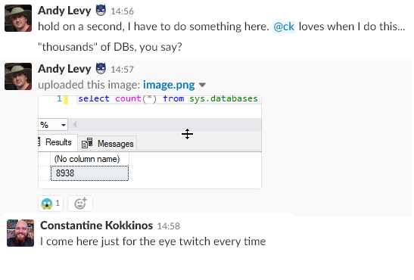
Where I’m Coming From
Notes:
When I started my job, I was floored by the number of databases. How do you do backups? When and how can you perform checkdb? How does anything work at this scale?

Slide 4
Agenda
Why Do We Script?
PowerShell ❤ SQL Server
Demos

Slide 5
Who am I?
Web Developer/Web Server Admin
Systems Integrator
Development DBA
Production DBA
dbatools Contributor
User Group Leader
SQL Saturday Organizer
Notes:
Since 1999
Visit & thank sponsors & volunteers

Slide 6
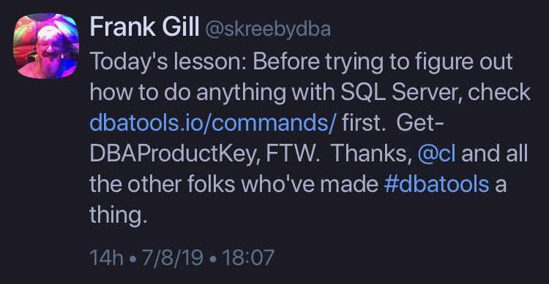
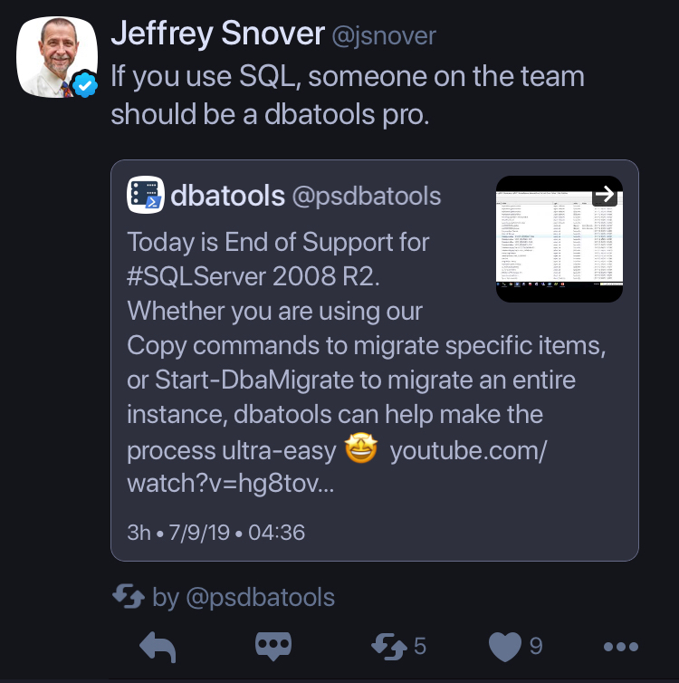
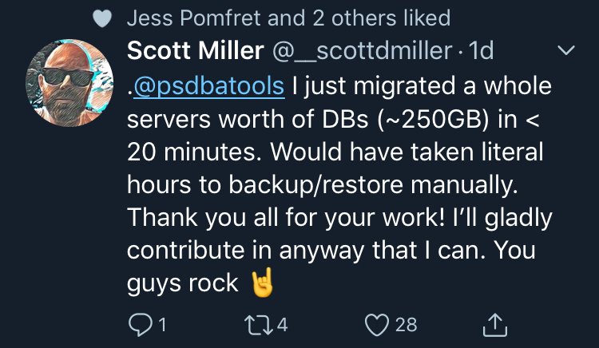
Testimonials
Notes:
Be the dbatools pro on your team

Slide 7

NASA Goddard Space Flight Center from Greenbelt, MD, USA [Public domain]

Slide 8
Why Script?
Scripting is communication
Trackable
Repeatable
Scalable
Notes:
Scripts are documentation and documentation is communication
Documentation is a love letter to your future self
Communication
Can put PowerShell snippets into your ticket notes
Communicate with peers, change managers
No one is reading your 30 page Word doc
Trackable - “You can’t put mouse clicks in source control” (Snover)

Slide 9
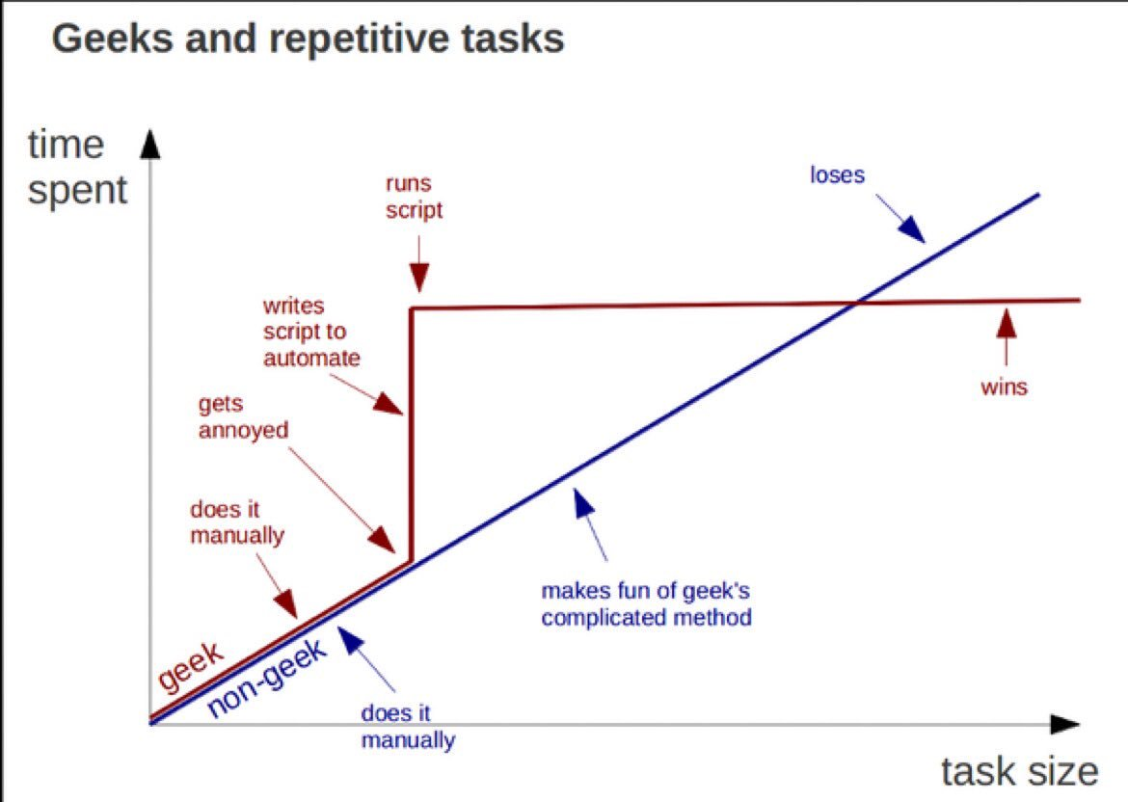
https://twitter.com/kirkdborne/status/804145411997007873

Slide 10
PowerShell & SQL Server
2008 - sqlps & PowerShell Agent Job Step
2016 - sqlserver
2017 - sqlserver in PowerShell Gallery
Good starting point
Notes:
Module and cut-down version of PowerShell. Don’t use any of these
Released with SSMS 2016, then sat idle
Moved to gallery April 2017
See Drew’s session for more detail

Slide 11
What is dbatools?
Open Source PowerShell module for data professionals
BDFL Chrissy LeMaire
Started July 2014
168 contributors
1.0 on June 20, 2019
Notes:
Single purpose - now almost 550 functions
Just passed 4000 PRs

Slide 12
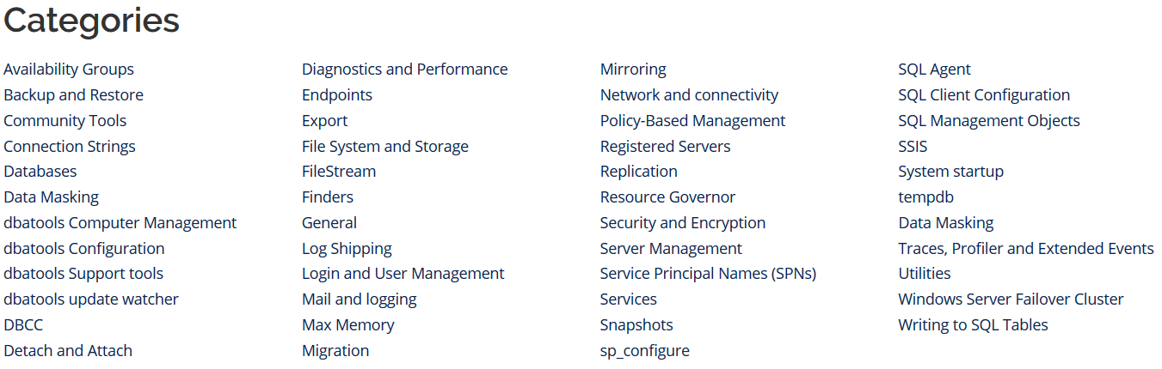
dbatools Functions
https://dbatools.io/commands/
https://docs.dbatools.io
Find-DbaCommand

Slide 13


dbatools vs. sqlserver
Mega multitool vs. Swiss Army Knife
Release frequency
Community-driven
Notes:
Sqlserver: 107 functions
Dbatools: 558 functions

Slide 14
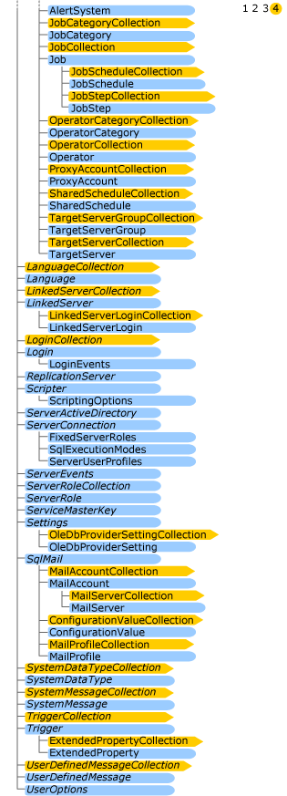
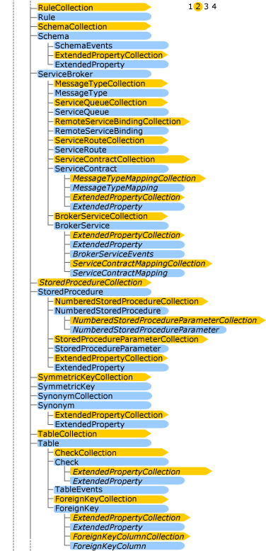
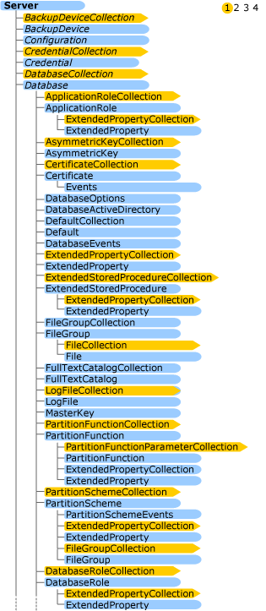
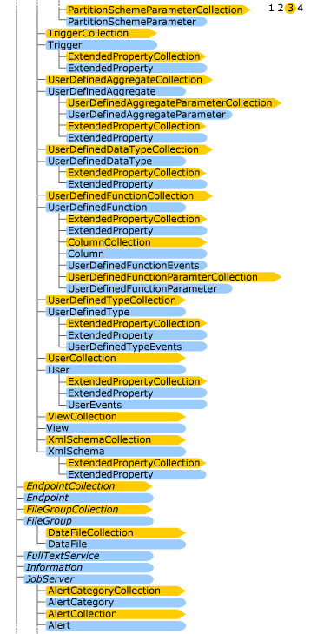
Server Management Objects
Underpinning of Management Studio, sqlserver and dbatools
Extensive compatibility
Can be unwieldy
https://docs.microsoft.com/en-us/sql/relational-databases/server-management-objects-smo/smo-object-model-diagram?view=sql-server-2017
Notes:
Works with Linux…mostly
Source: https://docs.microsoft.com/en-us/sql/relational-databases/server-management-objects-smo/smo-object-model-diagram?view=sql-server-2017

Slide 15


Slide 16


Slide 17
Get Involved!
https://dbatools.io/
Issues & Feature Request
Documentation
Slack!
Code!

Slide 18


Slide 19





Where to Find Me
https://flxsql.com/
andy@flxsql.com
@alevyinroc
Notes:
Slides are available now!

Slide 20


Slide 21
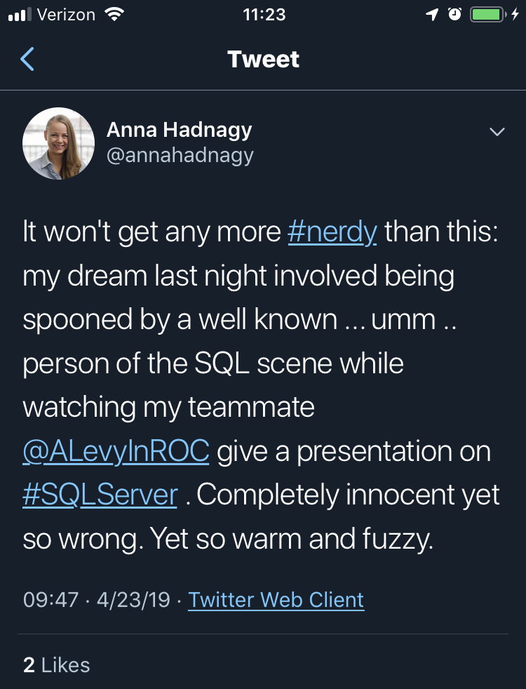
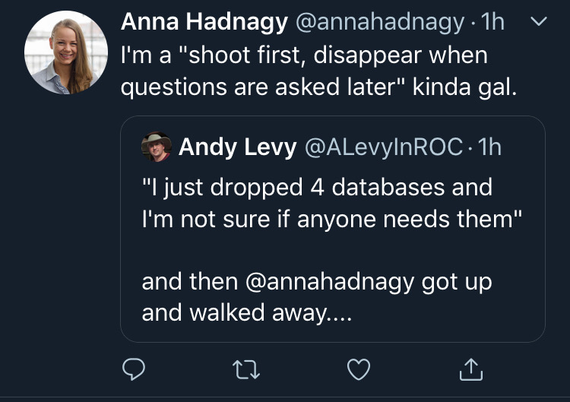
Who Am I?
Notes:
8K DBs - design problems get magnified at scale
She said I could!

